Slide 1


Data Curation Project
Group-26
Darshan Patel, Nancy Patel, Ajay Babu Popuri
College of Computing
Illinois Institute of Technology
1st Dec 2023
CS 520 & Data Integration, Warehousing, and Provenance
Dr. Boris Glavic

Slide 2

Introduction to Data Curation
Data Curation is the process of maintaining data to ensure that it is accurate and useful for its intended purpose. Data curation works with various steps to ensure that data is properly maintained for use and reuse.

Slide 3

Objectives and Purpose of the Project
Understanding the data and identifying problems with it.
Performing the essential data cleaning.
Transform the data as needed for analysis.
Implement quality checks to ensure the accuracy and consistency of the curated data.
Enhanced Data Accessibility
We strive to make the data easily accessible to researchers, scholars, and other stakeholders for future studies and collaborations with feature engineering.

Slide 4
Data Collection and Documentation
Billionaires Statistics Dataset (2023) The world's billionaires are profiled in this dataset, which also includes personal and business-related information.
Use Case
Wealth distribution analysis: Explore the distribution of billionaires' wealth across different industries, countries, and regions.
Demographic analysis: Investigate the age, gender, and birthplace demographics of billionaires.
It has 2640 rows and 35 columns.
Self-made vs. inherited wealth: Analyze the proportion of self-made billionaires and those who inherited their wealth.
Download : Kaggle
Economic indicators: Study correlations between billionaire wealth and economic indicators such as GDP, CPI, and tax rates.
Geospatial analysis: Visualize the geographical distribution of billionaires and their wealth on a map.
Trends over time: Track changes in billionaire demographics and wealth over the years

Slide 5
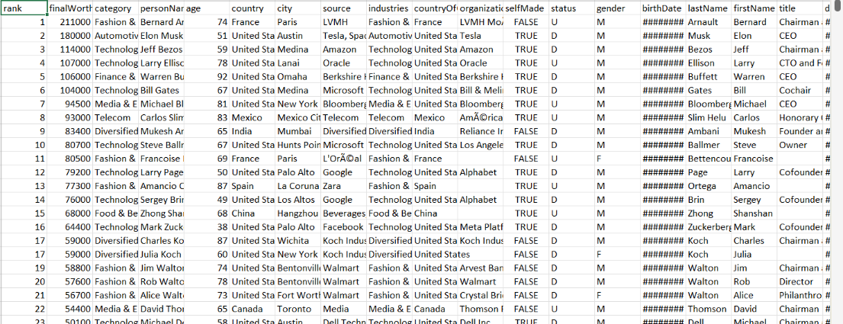
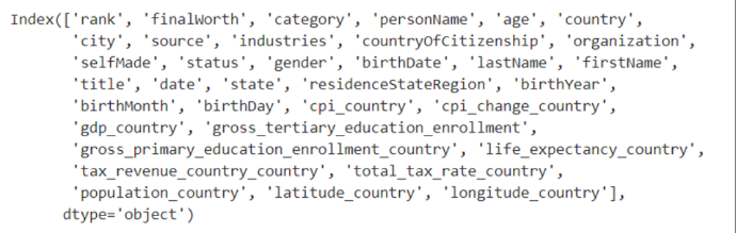
Dataset
Columns

Slide 6
Problems
1
Null Values
Remove Unnecessary data in column
2
3
Column Datatype are irrelevant
Redundant Data
4
5
Get missing locations in columns from longitude and latitude.

Slide 7
Tools and Methods
Vizier Tool
Jupyter Notebook
Libraries:
A Python client for various well-known geocoding websites is called Geopy.
Working with structured data, especially tabular data, can be facilitated by using Pandas, an open-source Python library that offers data structures and data analysis tools.
A set of functions for handling multidimensional arrays and multidimensional array objects make up the open-source Python library Numpy.
Matplotlibrary, Seaborn and Plotipy libraries for plotting cleaned data on various plot for better analysis.

Slide 8

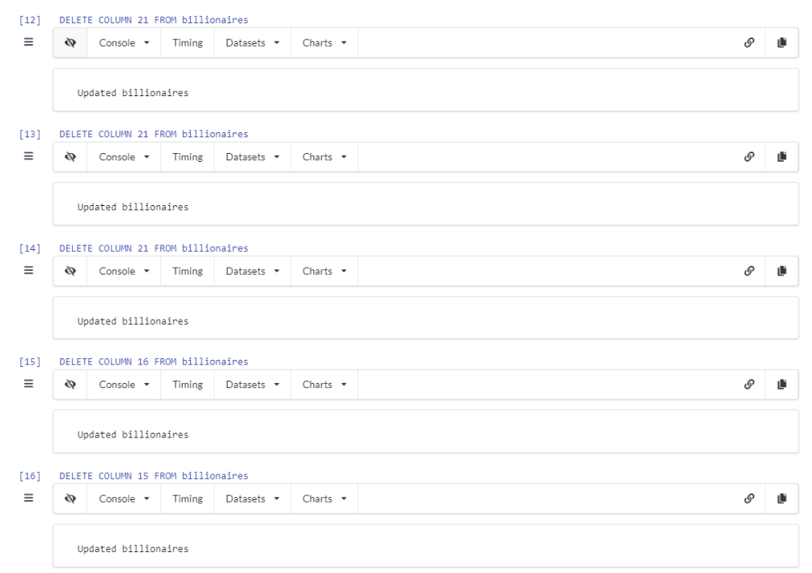
Solution 1 : Remove Redundant Column
Removing redundant column from dataset such as BIRTHYEAR, BIRTHDAY, BIRTHMONTH , LASTNAME and FIRSTNAME.

Slide 9
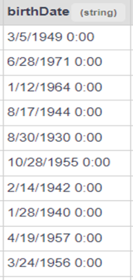
Solution 2 : Remove Unnecessary data in column
This consistent '0:00' notation misrepresents the birth times, potentially indicating the absence of specific time records.
Removing the '0:00' time component while preserving date information is necessary for accuracy.

Slide 10
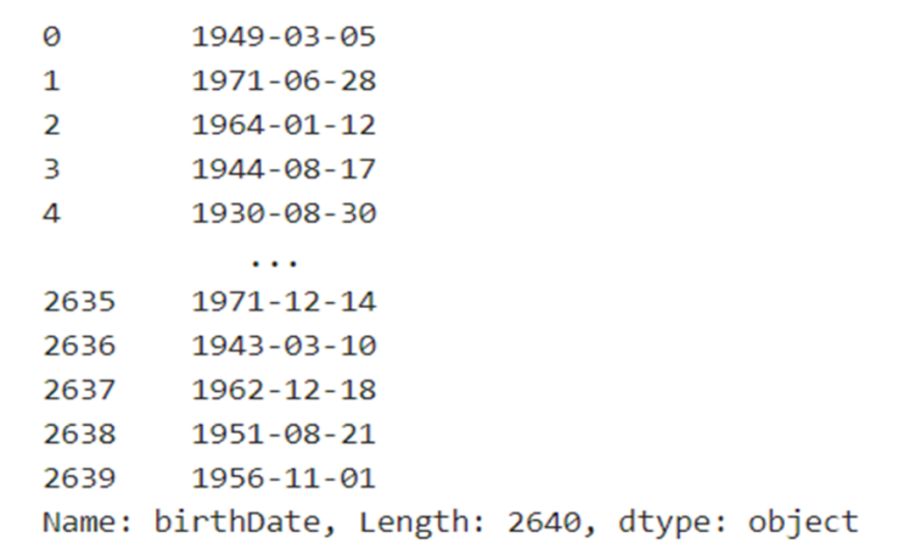
Result

Slide 11
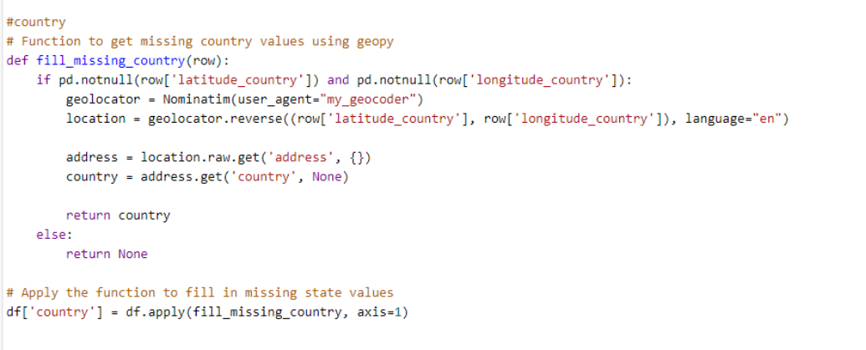
Solution 3 : Get missing location in column from longitude and latitude.
Utilizes GeoPy's reverse geocoding to infer missing 'country' values in a DataFrame based on available latitude and longitude coordinates.
Populates the 'country' column by applying a function that fetches country names from coordinates; assigns None for missing coordinates or unsuccessful geocoding.
Enhances dataset completeness by leveraging geolocation services to fill missing 'country' values from geographical coordinates.
State can be retrieve by this same method.

Slide 12
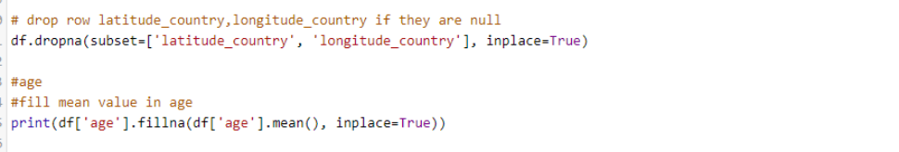
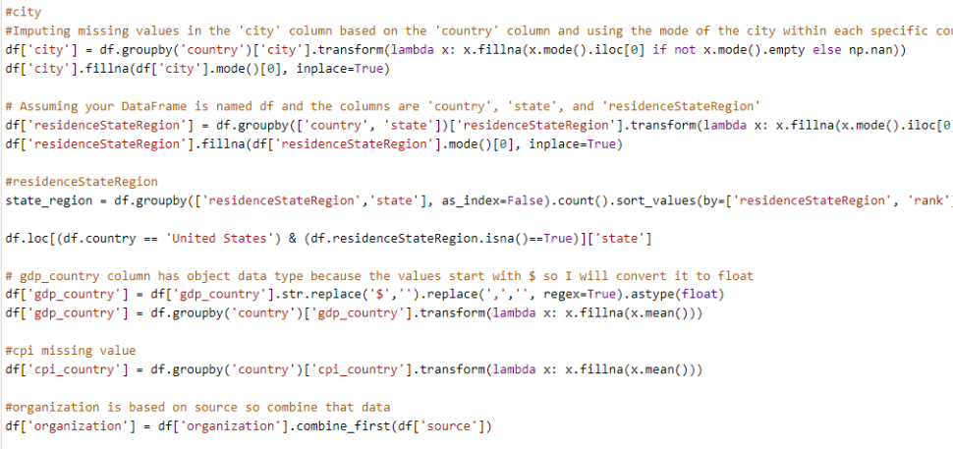
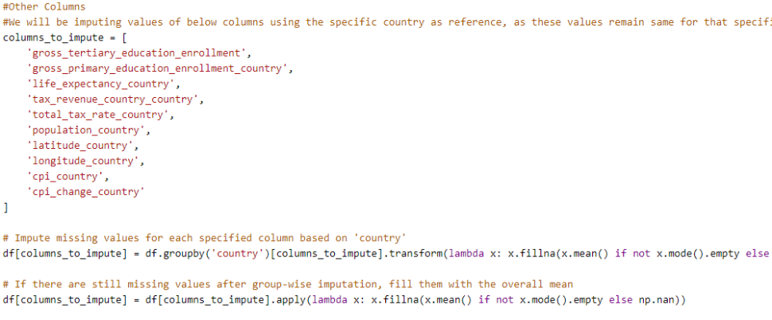
Solution 4: Null values

Slide 13
Datatype Validation
converting the 'birthDate' column to a DatetimeIndex.

Slide 14
Data Transformation
Data transformation using plots involves visualizing data in different ways to gain insights, identify patterns, and make informed decisions. Plots play a crucial role in transforming raw data into meaningful visual representations.

Slide 15
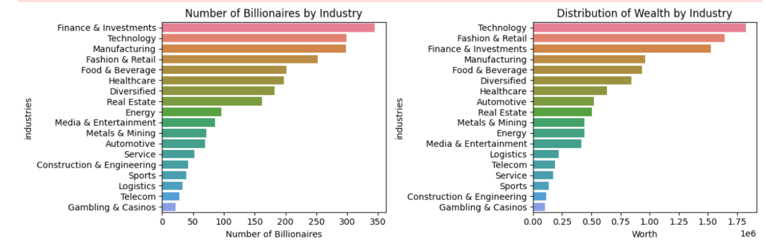
Billionaires by Category

Slide 16
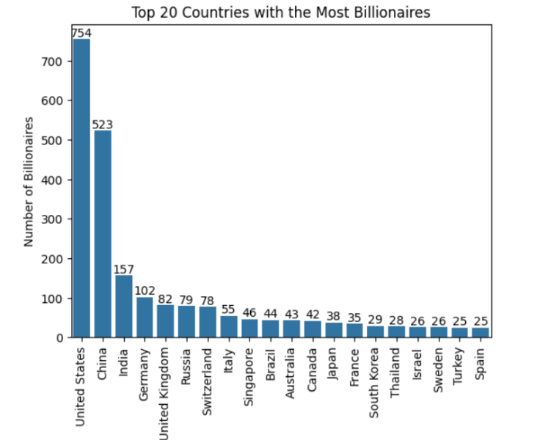
TOP 20 BILLIONAIRES HOLDING COUNTRIES

Slide 17
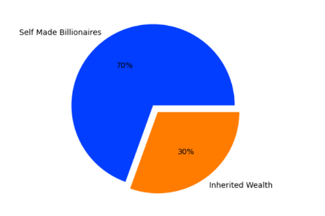
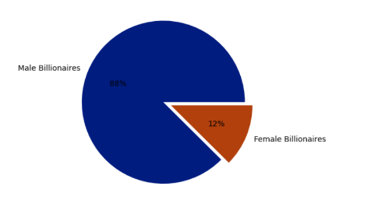
Percentage Count of Self-Made and Inherited Billionaires:
Percentage Count of Male and Female Billionaires:

Slide 18
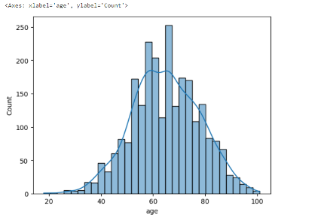
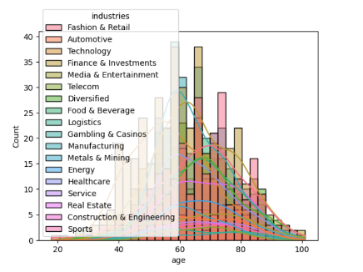
Distribution of Ages of Billionaires:
Distribution of Each Industry in Total Wealth Age vise

Slide 19
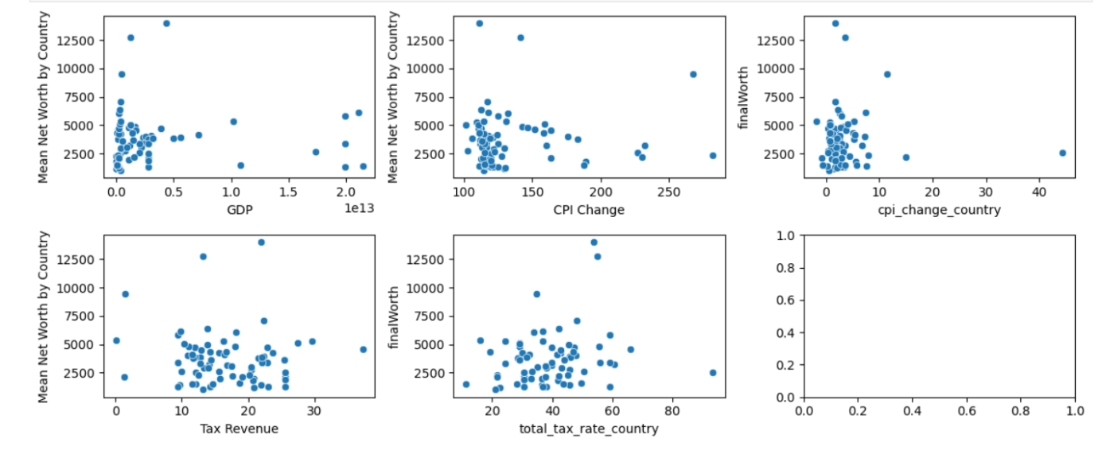
Correlations between Economic Indicators and Billionaires' Mean Net Worth by Country

Slide 20
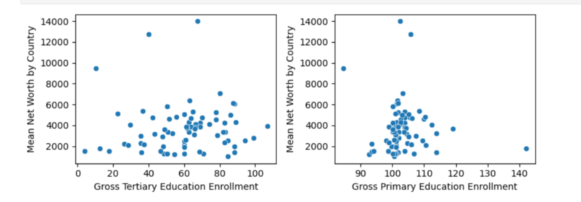
Association Between Education Enrollment Rates and Mean Net Worth of Billionaires by Country

Slide 21

Conclusion
we are able to understand the dealing with real world database and cleaning the dataset for accuracy. Data transformation purposes to ensure that data is in a suitable form for analysis, interpretation, and decision-making.

